Slide 1


Instrument Independent Reduction and Analysis
at ISIS and SNS
Nick Draper
Tessella

Slide 2
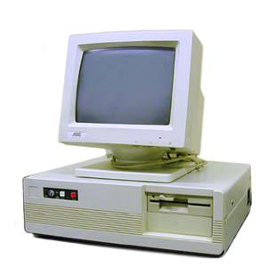
Project History
Previous software
  Developed separately by scientists / students
  Lots of repeated work
  Not actively maintained
  Patchy documentation
  No user consistency
  Unable to cope new data
Business Case
  Developed with a business focussed software company
    Created a good business case
    Alienated scientist user base
      Communication and expectation issues

Slide 3

Project Goals
Goals
  Consolidate the data analysis software for neutron scattering without restricting the needs of the instrument scientists
Key requirement
  Create a Data Analysis framework
    not instrument or technique/dependent
  Cross-platform
    Windows, Linux, Mac
  Easily extensible
  Freely redistributable

Slide 4
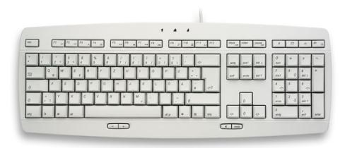
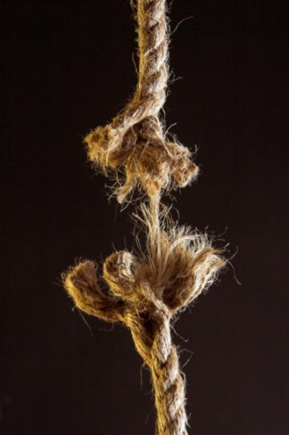
Framework vs individual applications
Less time spent developing input and output routines
More time on scientific algorithms
Cross benefits from other groups
Lower support requirements
Better documentation and training
Fewer single points of failure
Structure for further developments

Slide 5
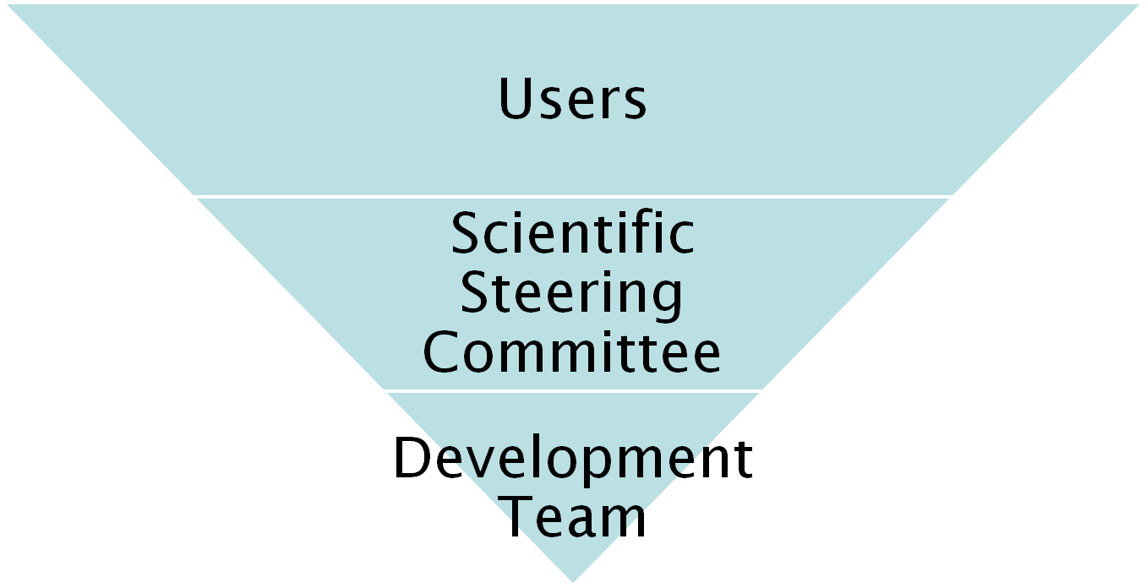
Project Organisation
27 beamlines, 1600 users
9 Key scientists representing every beamline.
PM &
7 Developers

Slide 6
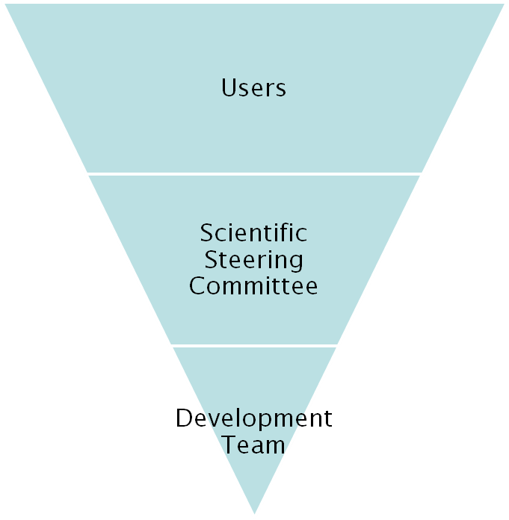
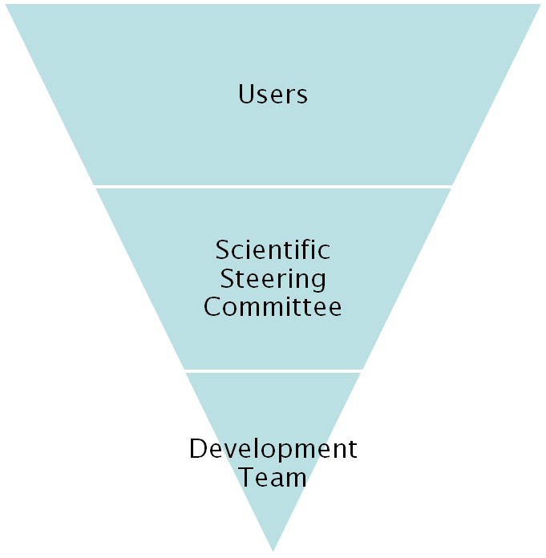
Project Organisation
ISIS
SNS/HIFR

Slide 7
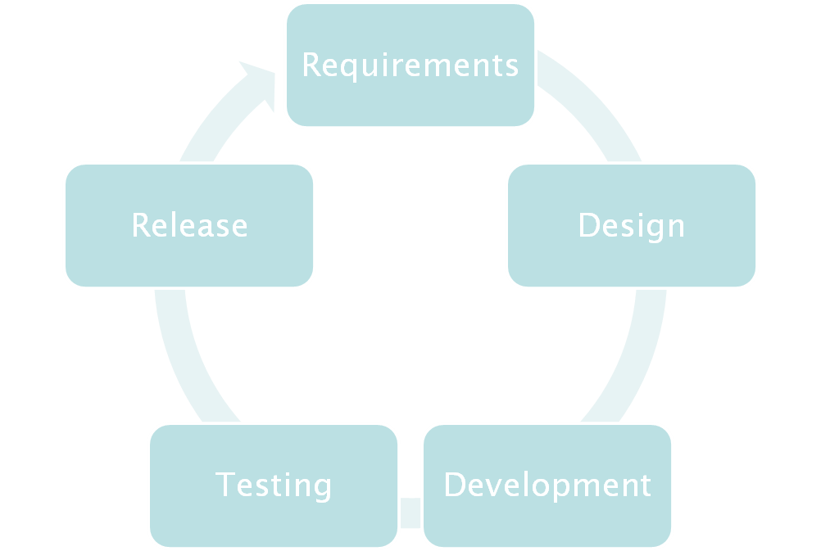

Iterative Development Process

Slide 8



Continuous Integration Environment
Deploy to
Download site
Mantid Project Wiki
Automated
System test
SVN
Repository
Build + unit test
-Linux
-Mac OSX
-Windows 32
-Windows 64
trac
Issue
tracking
system
Developers

Slide 9
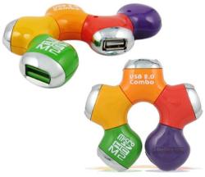
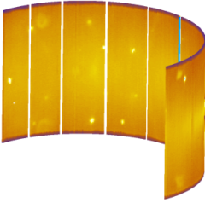
Design Criteria
Separation of Data and Algorithms
Encapsulated “User Code” in specific places
  Algorithms
  Workspaces
Use of well designed interfaces to allow generic use of components
Reuse of existing components
Careful memory management when handling large datasets

Slide 10



Architectural Design - Overview
Instrument log files
MantidScript
Command line & Scripting interface
RAW data files
Mantid Framework
API
Algorithms
Workspaces
MantidPlot Graphing and analysis
NEXUS data files
User Defined
User Defined
Matlab Interface
DAE direct access
Future Instrument specific UI
Future Instrument specific UI

Slide 11
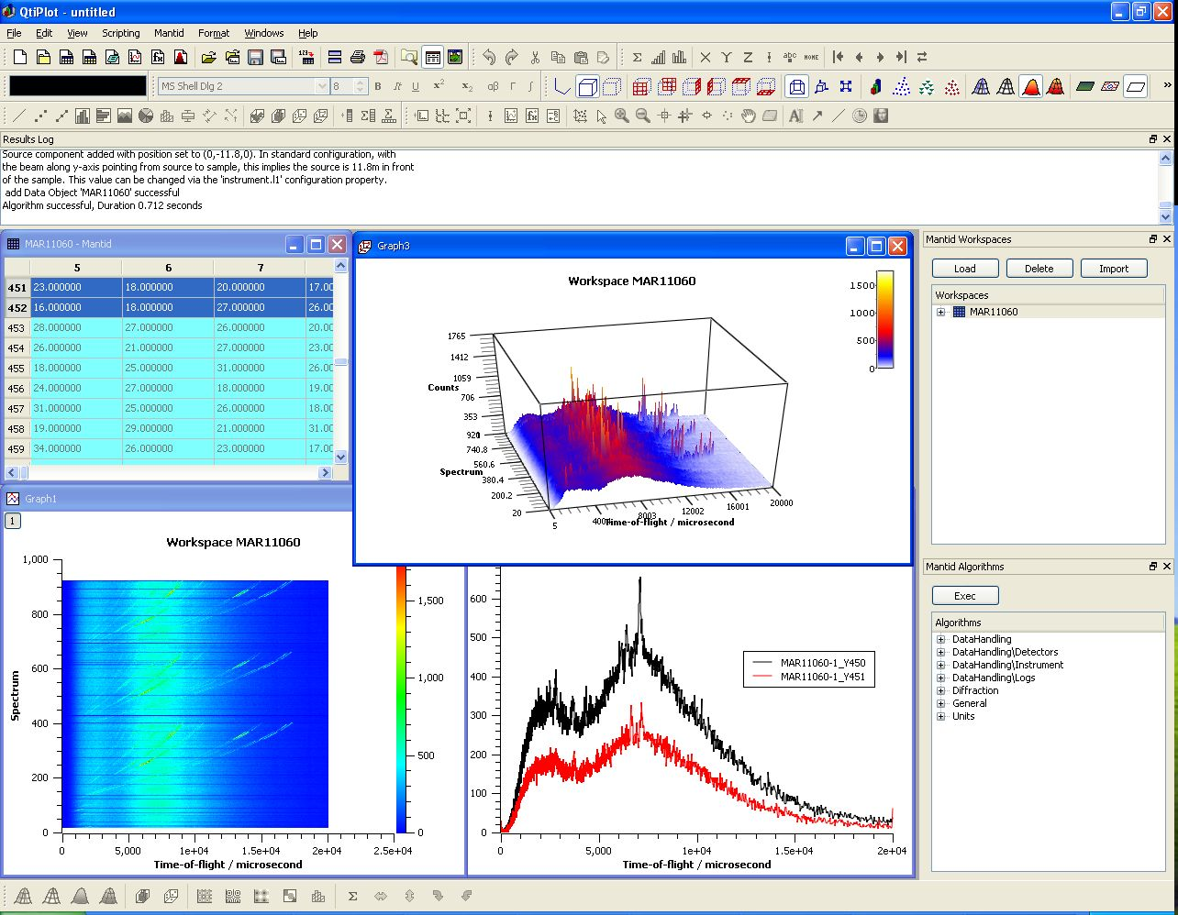
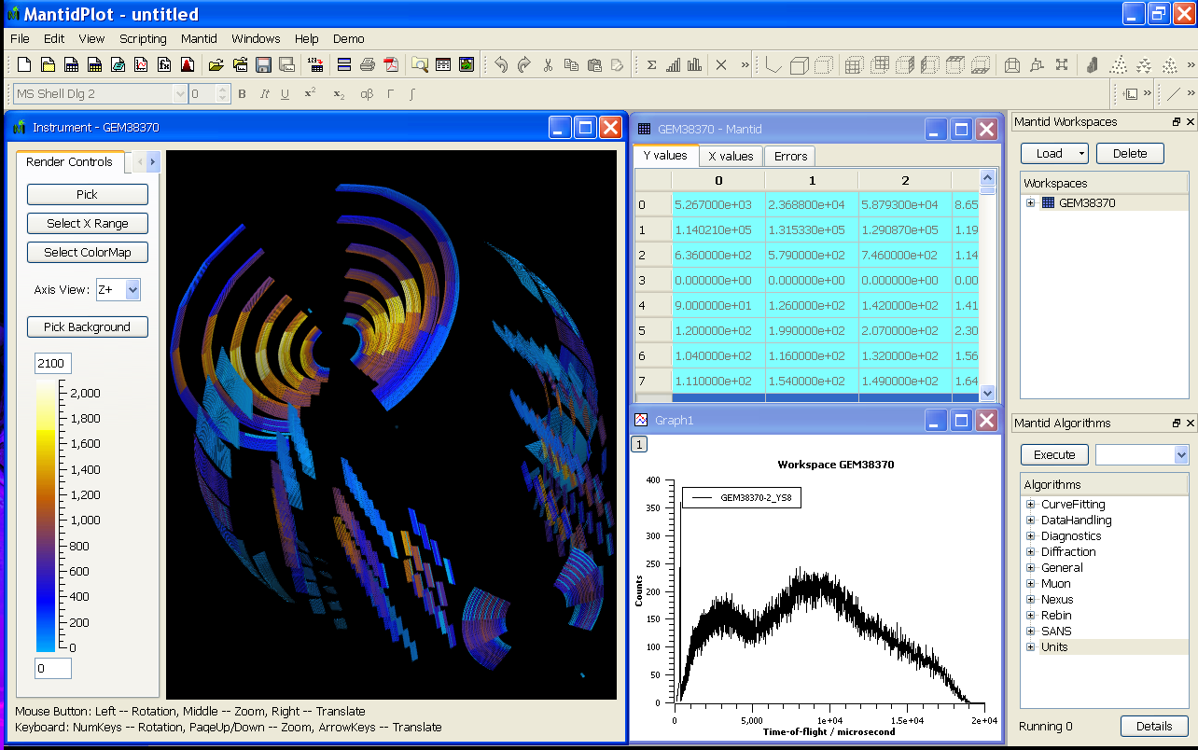
User Interfaces
Current Interfaces
  MantidPlot
    Plotting tool
    Data interaction and analysis.
    Instrument visualization

Slide 12
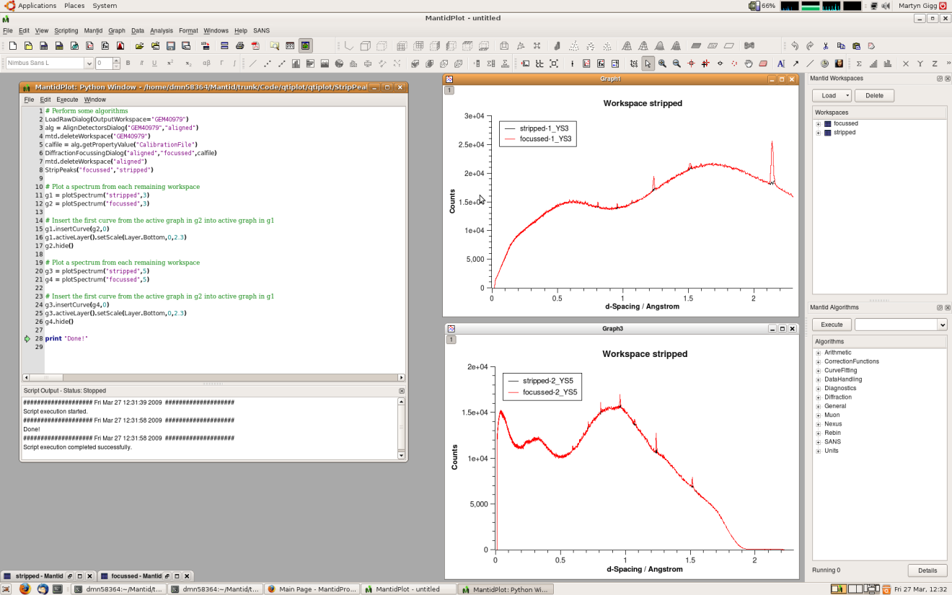
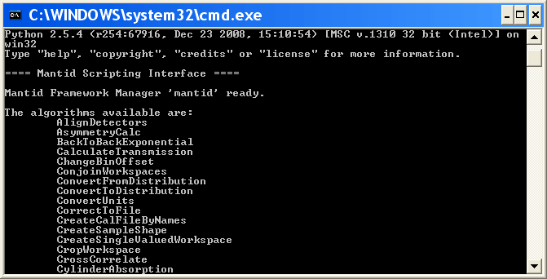
User Interfaces
Current Interfaces
  Python
    Command line access and scripting
    Python scripting language

Slide 13
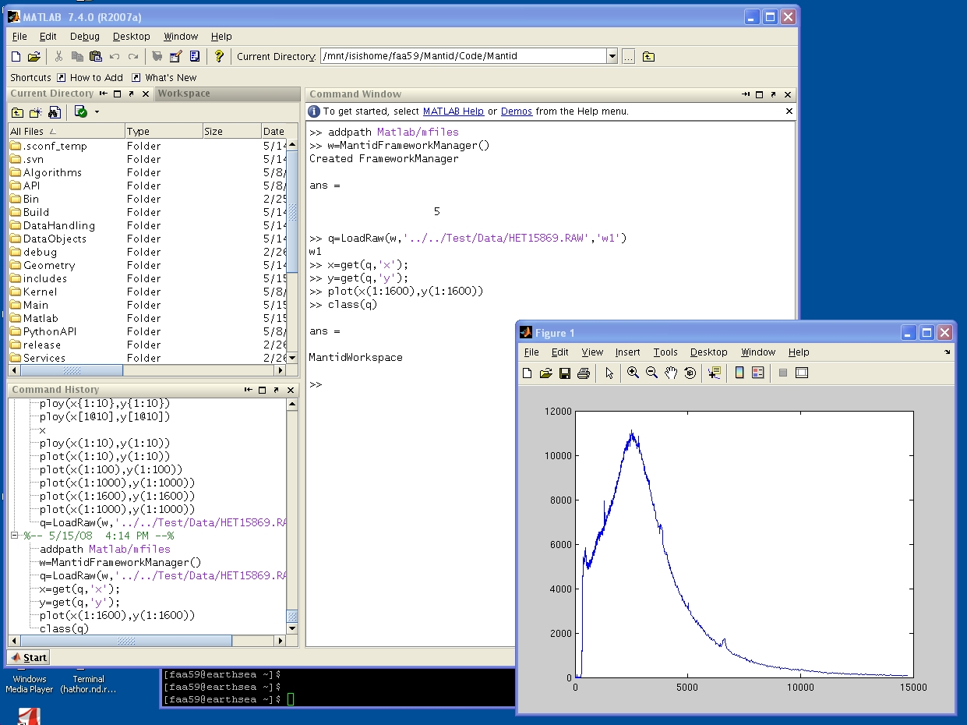
User Interfaces
Current Interfaces
  Matlab Interface
    Currently less advanced than other interfaces
    Further development planned

Slide 14
Algorithms
Arithmetic (+,-,*,/)
Correction & Normalisation
Curve Fitting & Peak finding
Data Handling
  Various file formats inc Nexus
Diagnostics
Diffraction
Muon
Rebining
SANS
Unit conversion

Slide 15
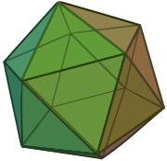

Geometry
Problem: How to maintain & visualise an accurate and fast representation of complex objects
Mesh Based
Easy, fast visualization
Poor computational accuracy & performance
Hard to define complex shapes
Surface Based
Hard, slow visualization
Good computational accuracy & performance
Easy to define objects using CSG

Slide 16
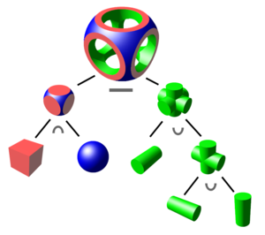


Geometry
Constructive Solid Geometry
  Building of complex shapes from
  intersections, unions and differences
  of common primitives
  Easily understood by users
Hybrid geometric model
Automated Surface triangulation
Surface CSG
Used for
Definition
Calculations
Mesh
Used for
Visualization
Approximation

Slide 17

Powder Diffraction, Instrumentation
& Curve fitting

Slide 18
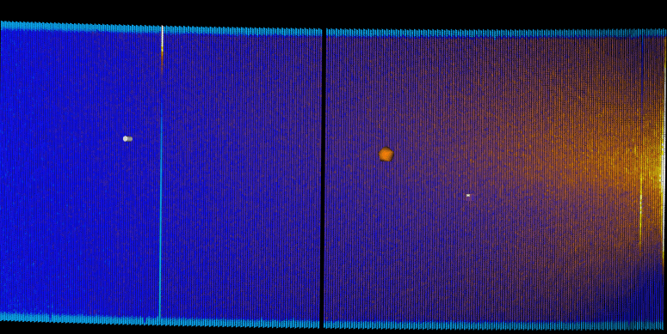
WISH Commissioning
No wiring inversion of tubes
Tube banks wired correctly
Two noisy tubes
Fast Neutron background from guide
but not from underneath!

Slide 19
User Extensible
Doesn’t have the algorithm you need?
Add it yourself

Slide 20
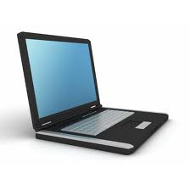

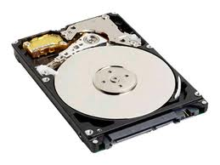
Advanced visualisation
Problem
  Large 100GB datasets
  4+ dimensions
    Q(x,y,z), ω, temp, field, etc.
Solution
  Distributed Parallel visualization
    VisIt, Paraview
  On the fly parallel data rebinning
DataFile
Your Laptop
Rebinning+Visualization
Servers

Slide 21
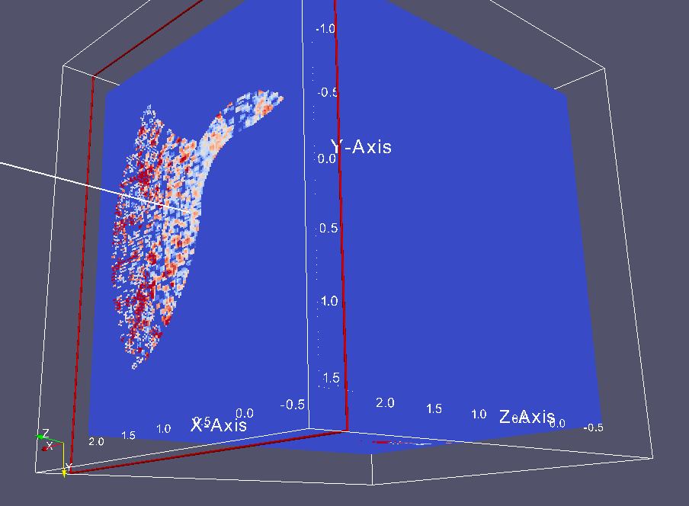
Multidimensional data visualisation

Slide 22
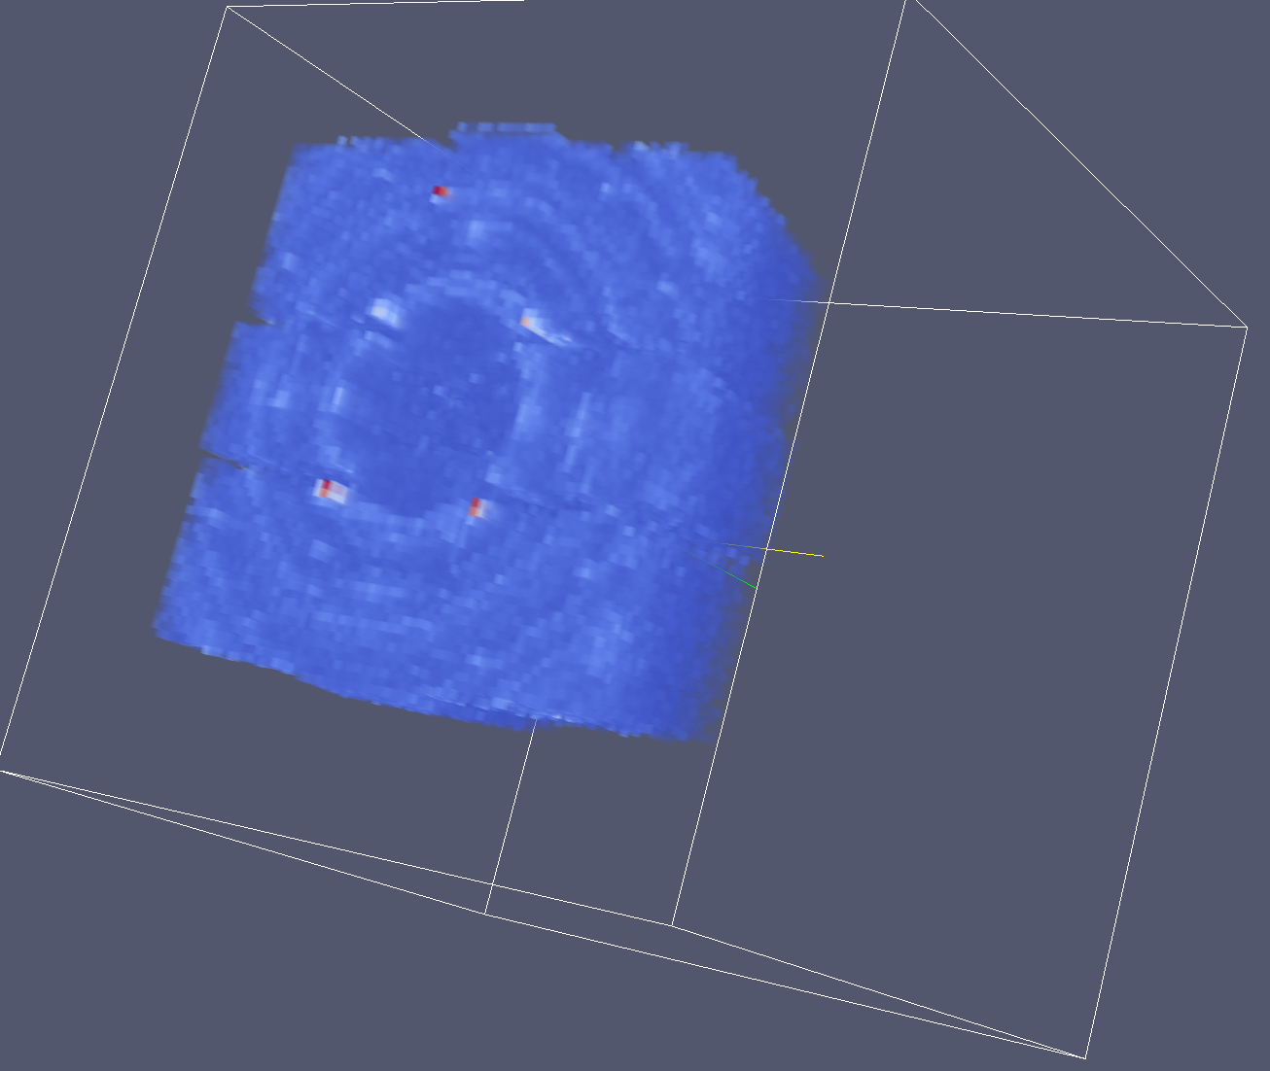

Volume Rendering

Slide 23
Further Information
Project Web Page
  www.mantidproject.org
Project Introduction Document
  http://svn.mantidproject.org/mantid/trunk/Documents/Requirements/Project%20Introduction%20Document.doc
User Requirements Document
  http://svn.mantidproject.org/mantid/trunk/Documents/Requirements/URD.doc
Architectural Design Document
  http://svn.mantidproject.org/mantid/trunk/Documents/Design/Architecture%20Design%20Document.doc

